Slide 1
Selenium WebDriver
Selenium-WebDriver Introduction and Implementation
LEVEL – LEARNER

Slide 2
Mehul Mehta(254777) , T, Senthilvel(260750) and KiranKumarGourisetty(169305)
Automation Center of Excellence
V1.0, 8/10/2012

Slide 3









Icons Used
Hands on Exercise
Questions
Tools
Coding Standards
Test Your Understanding
Reference
A Welcome Break
Demonstration
Contacts

Slide 4
Pre-requisites
Selenium Server File
Selenium JAR downloaded from http://seleniumhq.org/download/
Eclipse
Eclipse Classic version downloaded from http://www.eclipse.org/downloads/
JRE
JRE installed on required test machine. To check enter java –version in command prompt
JUnit
Download JUnit from http://www.junit.org/
TestNG
Download TestNG from http://testng.org or Install TestNG Eclipse Plug-in
Copy all the JAR files to single folder e.g. C:\SeleniumTesting and include this folder in WINDOWS PATH

Slide 5
Overview
Introduction:
Understanding Selenium WebDriver
Different types of WebDriver
Overview on WebDriver methods
Setup WebDriver project in Eclipse
Understanding JUnit
Writing test using JUnit

Slide 6
Objectives
After this chapter you will be able to:
Create WebDriver objects to work with different browsers.
Setup project in Eclipse and work with JUnit/ TestNG framework.

Slide 7
Selenium WebDriver Evolution
Selenium RC first came to life in 2004 when Jason Huggins was testing an internal application at ThoughtWorks.
He developed a Javascript library that could drive interactions with the page, allowing him to automatically rerun tests against multiple browsers.
Selenium RC was ground-breaking because no other product allowed you to control a browser from a language of your choice.
Selenium tests can be written in any of following language:
Java, C#, Python, Ruby, Perl and PHP
Selenium interacts with the UI elements of a web site using JavaScript injection
Limitation of Selenium RC
Restrictive to do different things due to the security limitations browsers apply to JavaScript (Uses JavaScript based automation engine)
Webapps became more and more powerful over time with special features and new browser support

Slide 8
Selenium WebDriver Evolution
WebDriver project developed by Simon Stewart at Google which works by accessing the OS and passing commands to the browser from the OS. Not constrained by the JavaScript Sandbox as Selenium RC is.
To overcome limitation offered by Selenium RC and to support broader range of browsers Selenium RC and WebDriver is merged to form Selenium WebDriver
The downside to Selenium WebDriver is that it requires new implementations for each of the browsers that it works against. This is due to each browser having its own access points with the Operating System.

Slide 9
Understanding Selenium WebDriver
WebDriver is used for automating web applications.
WebDriver ’s goal is to provide a well-designed object-oriented API that provides improved support for modern advanced web-app testing problems
WebDriver supports dynamic web pages where elements of a page may change without the page itself being reloaded
WebDriver Scripts can be written in any one of following languages:
Java
C#
Python
Ruby
Perl
PHP

Slide 10
Different types of WebDriver
Name of driver | OS Supported | Class to instantiate
HtmlUnitDriver | All | org.openqa.selenium.htmlunit.HtmlUnitDriver
FirefoxDriver | All | org.openqa.selenium.firefox.FirefoxDriver
InternetExplorerDriver | Windows | org.openqa.selenium.ie.InternetExplorerDriver
ChromeDriver | All | org.openqa.selenium.chrome.ChromeDriver
SafariDriver | MAC | org.openqa.selenium.safari.SafariDriver
In addition, WebDriver is also available for Mobile testing:
Name of driver | OS Supported | Class to instantiate
AndroidDriver | All | org.openqa.selenium.android.AndroidDriver
IPhoneDriver | All | org.openqa.selenium.iphone.IPhoneDriver

Slide 11
HtmlUnitDriver Instantiation
Emulating a Specific Browser
Using Browser Version
HtmlUnitDriver driver = new HtmlUnitDriver(BrowserVersion.FIREFOX_3_6);
Using Capabilities
HtmlUnitDriver driver = new HtmlUnitDriver(capabilities);
The fastest and most lightweight implementation of WebDriver
Pros
Fastest implementation of WebDriver
A pure Java solution and so it is platform independent.
Supports JavaScript
Cons
It's not graphical, which means that you can't watch what's happening

Slide 12
FirefoxDriver Instantiation
FireFoxDriver Instantiation process
WebDriver driver = new FirefoxDriver()
This will invoke firefox browser and returns an handle in form of WebDriver object which is used to interact with the browser.

Slide 13
InternetExplorerDriver Instantiation
InternetExplorerDriver Instantiation process
To work with IE, first download IEDriverServer.exe file from
http://code.google.com/p/chromedriver/downloads/list and keep it is your project resources folder.
Set Webdriver.ie.driver property
System.setProperty("Webdriver.ie.driver","src/main/resources/drivers/ie/IEDriverServer.exe")
WebDriver driver = new InternetExplorerDriver ()
This will invoke Internet explorer browser and returns a handle in form of WebDriver object which is used to interact with the browser.

Slide 14
ChromeDriver Instantiation
ChromeDriver Instantiation process
To work with Chrome, first download chrome server file from http://code.google.com/p/chromedriver/downloads/list and place in project resources folder.
Set Webdriver.chrome.driver property
System.setProperty("Webdriver.chrome.driver","src/main/resources/drivers/chrome/chromedriver.exe");
Instantiate a WebDriver implementation
WebDriver WebDriver = new ChromeDriver();

Slide 15
IPhone & Android Driver Instantiation
Test can be executed against emulators and real devices for IPhone and Andorid OS.
IPhoneDriver Instantiation process
To work with Iphone, first do the setup as given in following page: http://code.google.com/p/selenium/wiki/IPhoneDriver.
Instantiate a WebDriver implementation
WebDriver WebDriver = new IPhoneDriver();
Andorid Instantiation process
To work with Andorid, first do the setup as given in following page: http://code.google.com/p/selenium/wiki/AndroidDriver.
Instantiate a WebDriver implementation
WebDriver WebDriver = new AndoridDriver();

Slide 16
WebDriver Useful Methods
get
void get(java.lang.String url) Load a new web page in the current browser window. Parameters: url - The URL to load. It is best to use a fully qualified URL Ex - WebDriver .get(“http://ww.google.com”);
getTitle
java.lang.String getTitle() The title of the current page. Returns: The title of the current page, with leading and trailing whitespace stripped, or null if one is not already set Ex - WebDriver .getTitle( );

Slide 17
WebDriver Useful Methods
close
void close() Close the current window, quitting the browser if it's the last window currently open. Ex - WebDriver .close();
quit
void quit() Quits this driver, closing every associated window. Ex - WebDriver .quit( );

Slide 18
WebDriver - Browser Navigation Methods
Method | Description | example
back() | Move back a single "item" in the browser's history. | Wedriver.navigate().back();
forward() | Move a single "item" forward in the browser's history. | Wedriver.navigate().forward();
refresh() | Refresh the current page | Wedriver.navigate().refresh();
to(java.lang.String url) | Load a new web page in the current browser window. | Wedriver.navigate().to (“http://www.cognizant.com”);

Slide 19
WebDriver Methods – To switch between Windows
Method | Description | example
java.util.Set<java.lang.String> getWindowHandles() | A set of window handles which can be used to iterate over all open windows. | Wedriver.getWindowHandles();
alert() | Switches to the currently active modal dialog for this particular driver instance. | Wedriver. switchTo().alert();
defaultContent() | Selects either the first frame on the page, or the main document when a page contains iframes. | Wedriver. switchTo() .defaultContent();
window(java.lang.String nameOrHandle) | Switch the focus of future commands for this driver to the window with the given name/handle. | Wedriver. switchTo(). window(“id”);

Slide 20
Demonstration

Slide 21
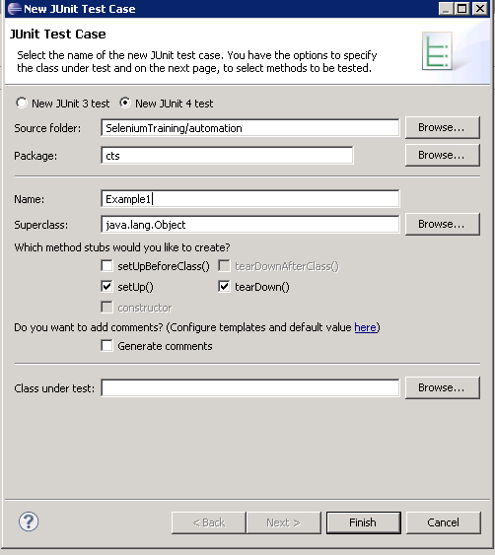
Automation project setup - JUnit
Create New Project in Eclipse.
Add all JAR files in the Java Build Path of the project.
Add new class using JUnit Test Case Builder. To invoke builder select File-> New-> Junit Test Case and then enter required fields as shown below

Slide 22
Understanding JUnit annotation
@Before
It is used to execute set of preconditions before executing a test. For example, if there is a need to open some application and create a user before executing a test, then this annotation can be used for that method.
Method that is marked with @Before will be executed before executing every test in the class.
@After
Method that is marked with @After gets executed after execution of every test. If we need to reset some variable after execution of every test then this annotation can be used with a method that has the needed code.
@BeforeClass
If a JUnit test case class contains lot of tests which all together need a method which sets up a precondition and that needs to be executed before executing the Test Case class then we can utilize @BeforeClass annotation.
@AfterClass
This annotation can be used to execute a method that needs to be executed after executing all the tests in a JUnit Test Case class.

Slide 23
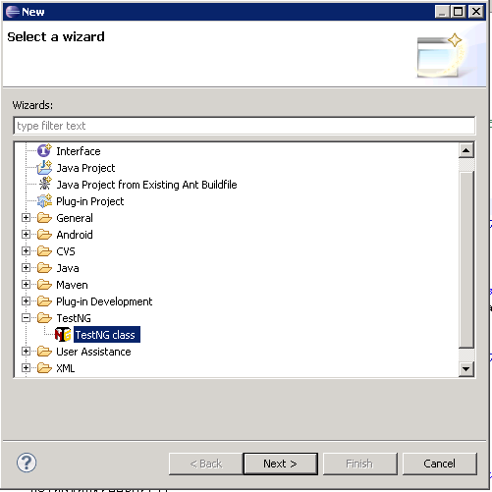
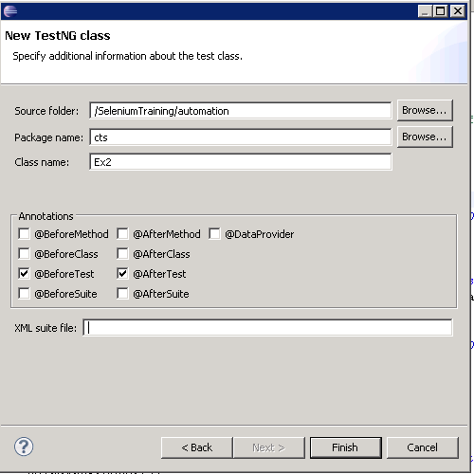
Automation project setup - TestNG
Install TestNG plugin into Eclipse.
Create new class by using TestNG class builder by clicking on File->New->Other.

Slide 24
Understanding TestNG annotation
We have annotation similar to Junit
@BeforeTest
This annotation is similar to Junit @Before where in method marked by it will be executed before executing every test in the class.
@AfterTest
This annotation is similar to Junit @After where in method marked by it will be executed after executing every test in the class.
@BeforeClass
If a TestNG test case class contains lot of tests which all together need a method which sets up a precondition and that needs to be executed before executing the Test Case class then we can utilize @BeforeClass annotation.
@AfterClass
This annotation can be used to execute a method that needs to be executed after executing all the tests in a TestNG Test Case class.

Slide 25
Automate Test Scenario
Launch Firefox and go to www.google.com
Enter Selenium Testing in Search Textbox
Click on Search Button
Confirm that Browser title is set “Selenium Testing”
Close Browser
Sample Code
WebDriver driver = new FirefoxDriver();
// And now use this to visit Google
driver.get("http://www.google.com");
// Find the text input element by its name
WebElement element = driver.findElement(By.name("q"));
// Enter something to search for
element.sendKeys("Selenium Testing ");
// Now submit the form. WebDriver will find the form for us from the element
element.submit();
// Check the title of the page
System.out.println("Page title is: " + driver.getTitle());
//Close the browser
driver.quit();

Slide 26
JUnit Design
Code in JUnit Format.
@Before
public void setUp() throws Exception {
driver = new FirefoxDriver();
baseUrl = "https://www.google.com/";
driver.manage().timeouts().implicitlyWait(30, TimeUnit.SECONDS);
}
@Test
public void test() throws Exception {
driver.get(baseUrl );
WebElement element = driver.findElement(By.name("q"));
element.sendKeys("selenium testing");
element.submit();
assertEquals("selenium testing - Google Search", driver.getTitle());
}
@After
public void tearDown() throws Exception {
driver.quit();
}

Slide 27
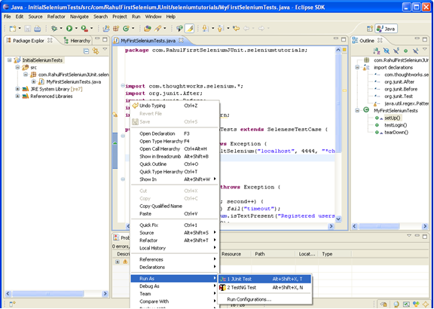
Running Script
Running Script
Now you are all set to run your first script in Junit
Right click on test and then select ‘Run As-Junit test’

Slide 28
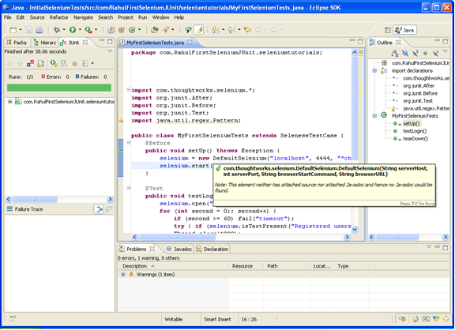
Running Script
You can view the result after execution.

Slide 29
Demonstration

Slide 30
Exercise
Modify the test to run against
Internet Explorer
Chrome

Slide 31
Questions

Slide 32
Break

Slide 33
Test Your Understanding
Instructions:
Which WebDriver is having non-graphical interface?
Which WebDriver version to be instantiated to work with Firefox?
Which property to set to work with Chrome browser?
Which method to use navigate to test URL?
Which method to use for doing back action on browser?
Which method to use to close browser window?

Slide 34
Summary
WebDriver Implementation
Eclipse Setup

Slide 35
Source
WebDriver documentation - http://seleniumhq.org/docs/
WebDriver Package details -http://selenium.googlecode.com/svn/trunk/docs/api/java/index.html
Disclaimer: Parts of the content of this course is based on the materials available from the Web sites and books listed above. The materials that can be accessed from linked sites are not maintained by Cognizant Academy and we are not responsible for the contents thereof. All trademarks, service marks, and trade names in this course are the marks of the respective owner(s).

Slide 36
Selenium WebDriver
You have successfully completed -
Selenium-WebDriver Introduction and Implementation

